Slide 1




SePer: Measure Retrieval Utility through Semantic Perplexity Reduction
Spotlight
Lu Dai, Yijie Xu, Jinhui Ye, Hao Liu, Hui Xiong HKUST(GZ), HKUST, CMU
Lu Dai
2025.5.21

Slide 2
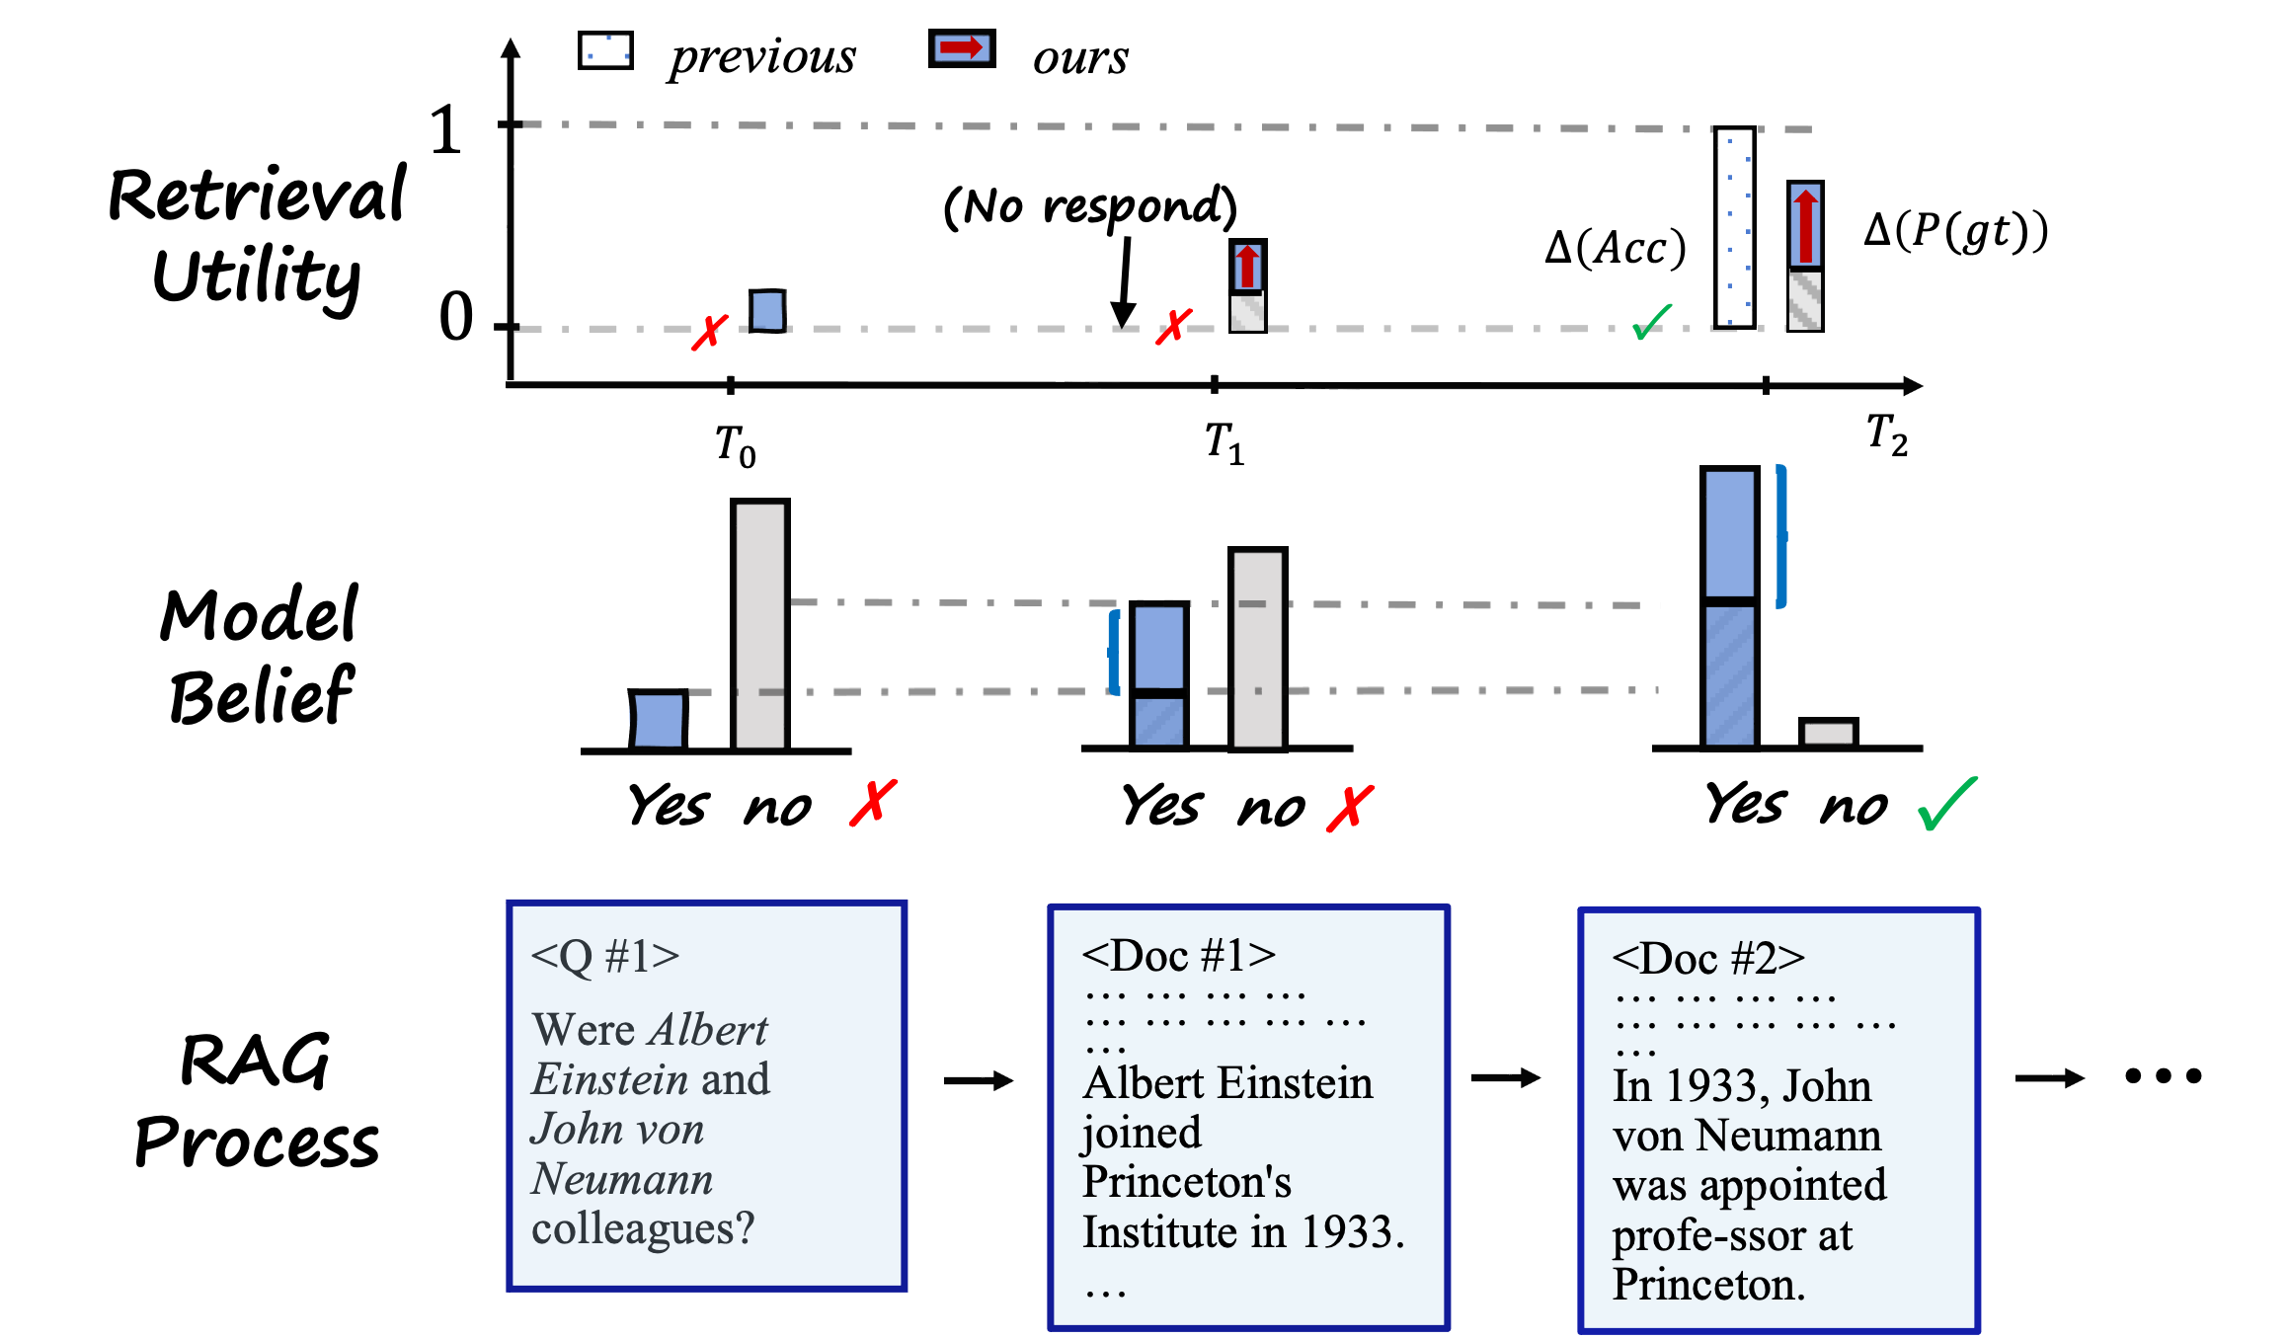
RESEARCH PROBLEM
The Evaluation Puzzle:
How to evaluate modules in retrieval-augmented generation (RAG) ?
Yes
Question
Retreival
Answer

Slide 3
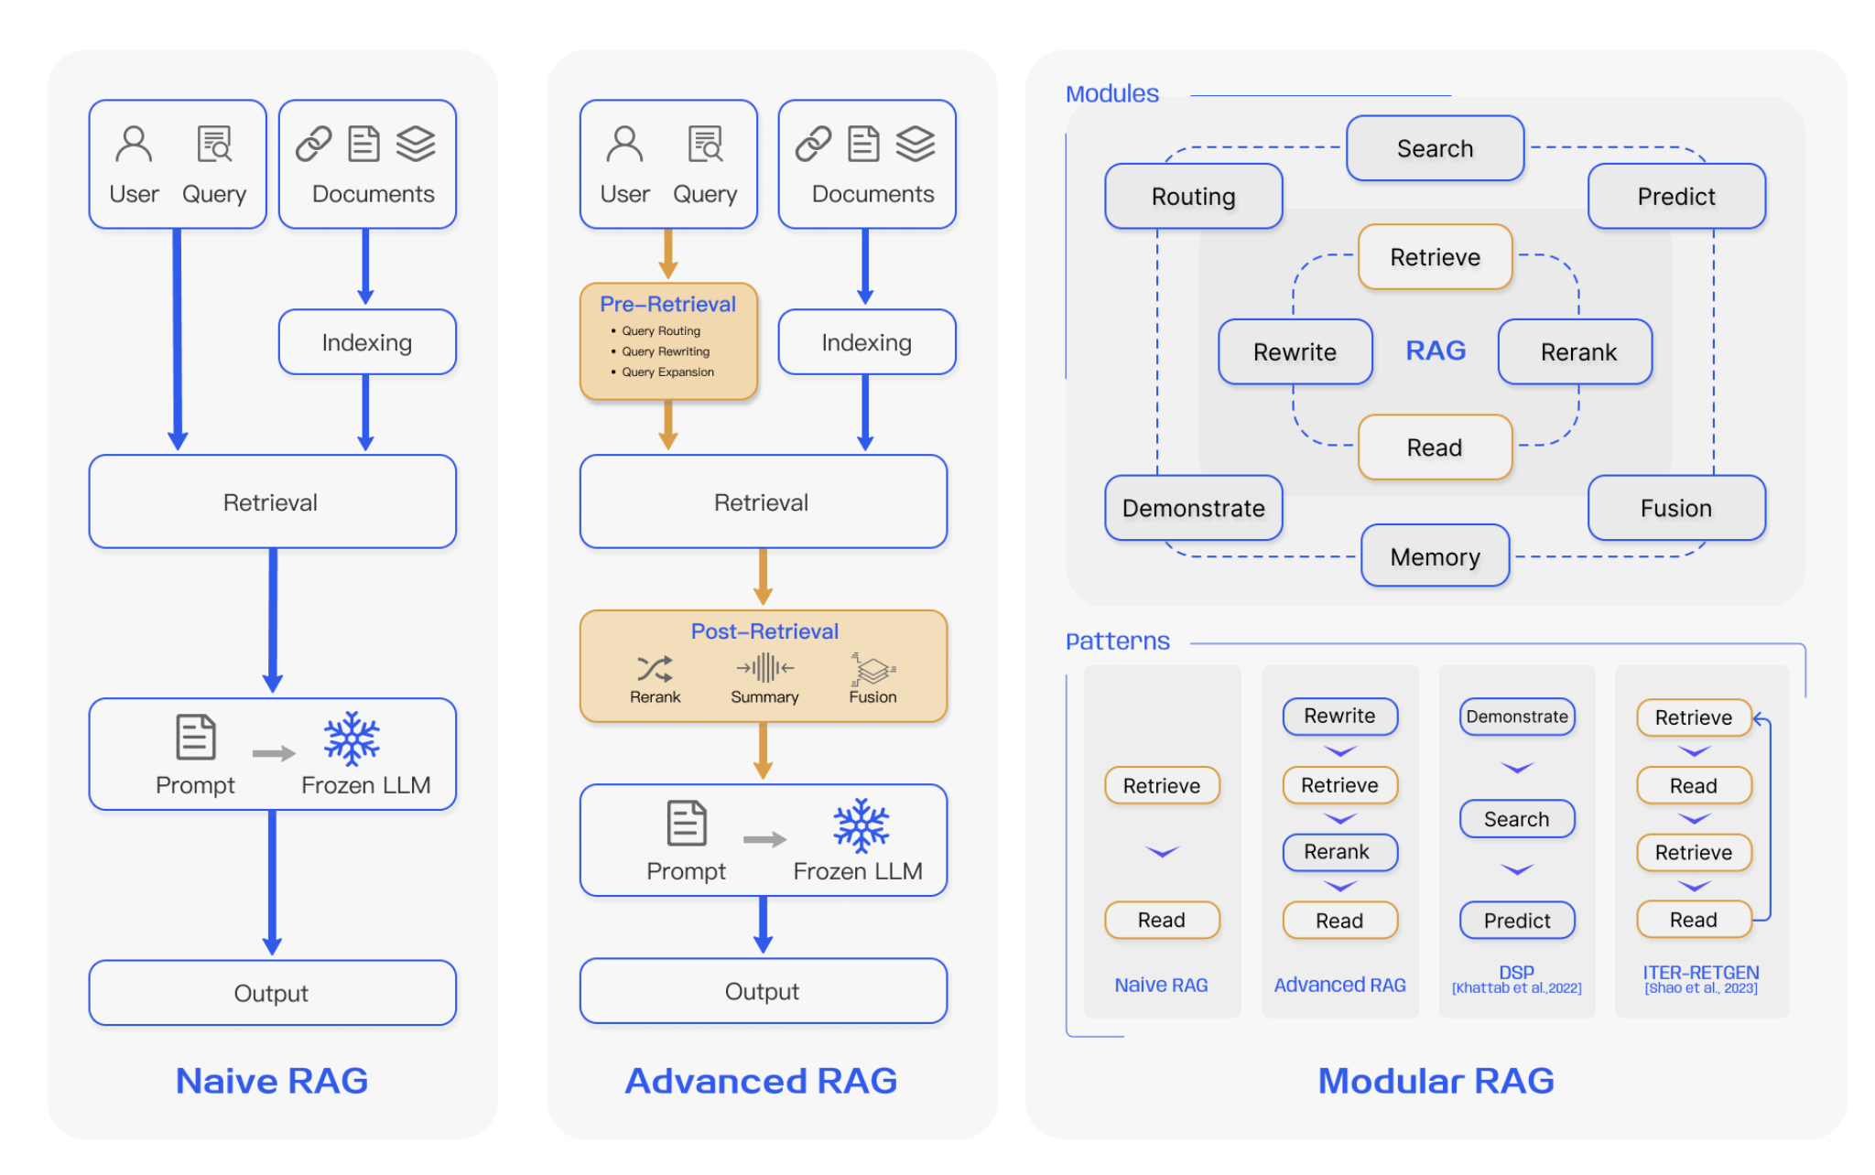
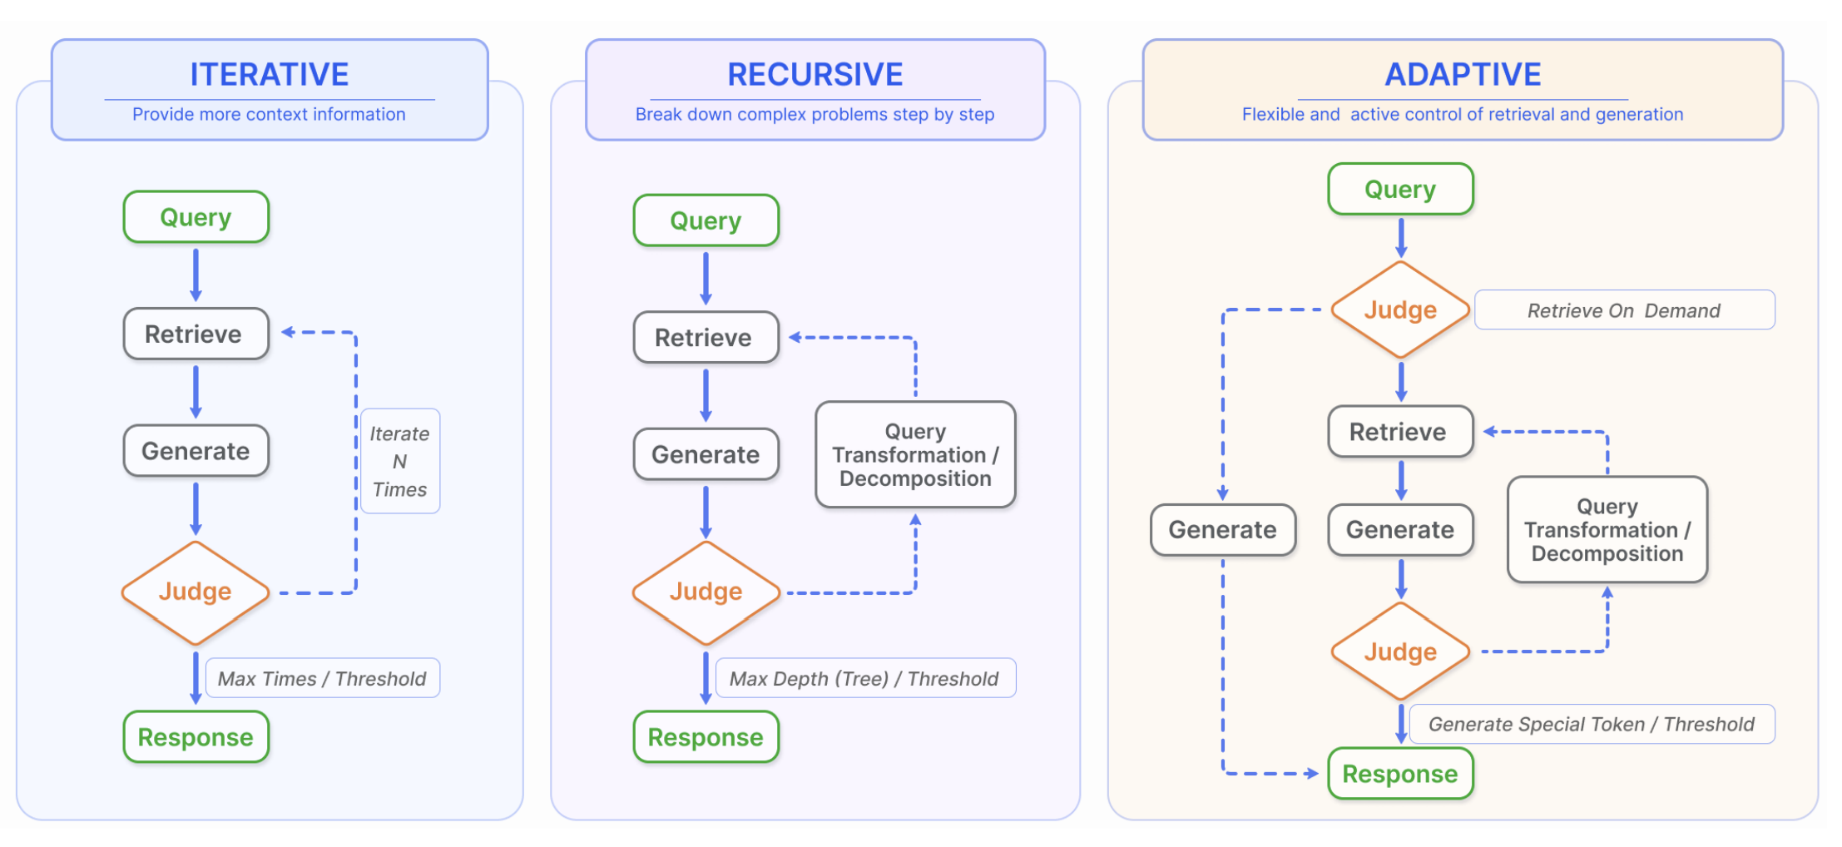
RESEARCH PROBLEM
The Evaluation Puzzle:
How to evaluate modules in retrieval-augmented generation (RAG) ?
Retrieval-Augmented Generation for Large Language Models: A Survey. Gao et al. 2023.

Slide 4
RESEARCH GAP
Weakness of current RAG evaluation methods:
Traditional Metric:
Exact Match
BLEU
ROUGE
…
MRR, NDCG,
Recall@K
Ambiguous criterion:
Lack of consistency/clarity of rubrics definition
Low Sensitivity:
Cannot quantify individual helpfulness of intermediate documents
Cannot separate the effect of different module
High Cost:
Depends on commercial LLMs (GPT-4/Claude) or real human for reliable evaluation
LLM-based Metric:
BERTScore / GPTScore
G-Eval / RAGAS
Auto-J/Prometheus
LLM-Arena
…

Slide 5

SOLUTION
Idea
Quantify the utility of retrieval by the belief shift it brings to LLM
Intuition
Formal Definition
Retrieval utility U(M,D) is defined as:
Where D is the retrieved documents and M is the receiver model.

Slide 6
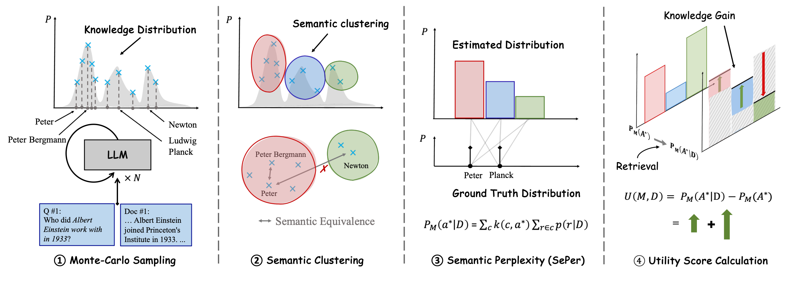
SOLUTION
Algorithm Illustration
Algorithm Details

Slide 7
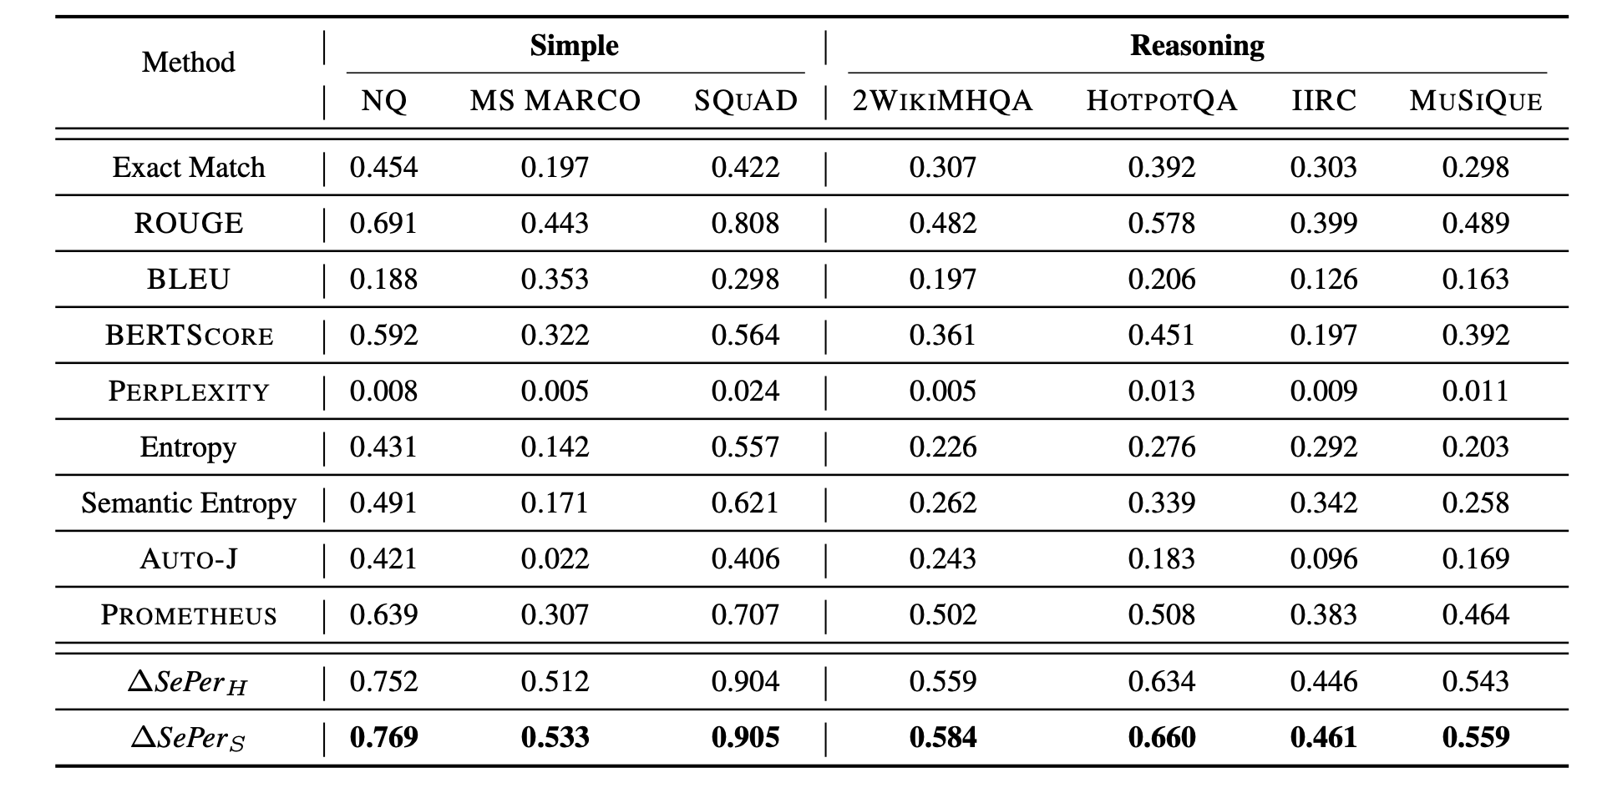
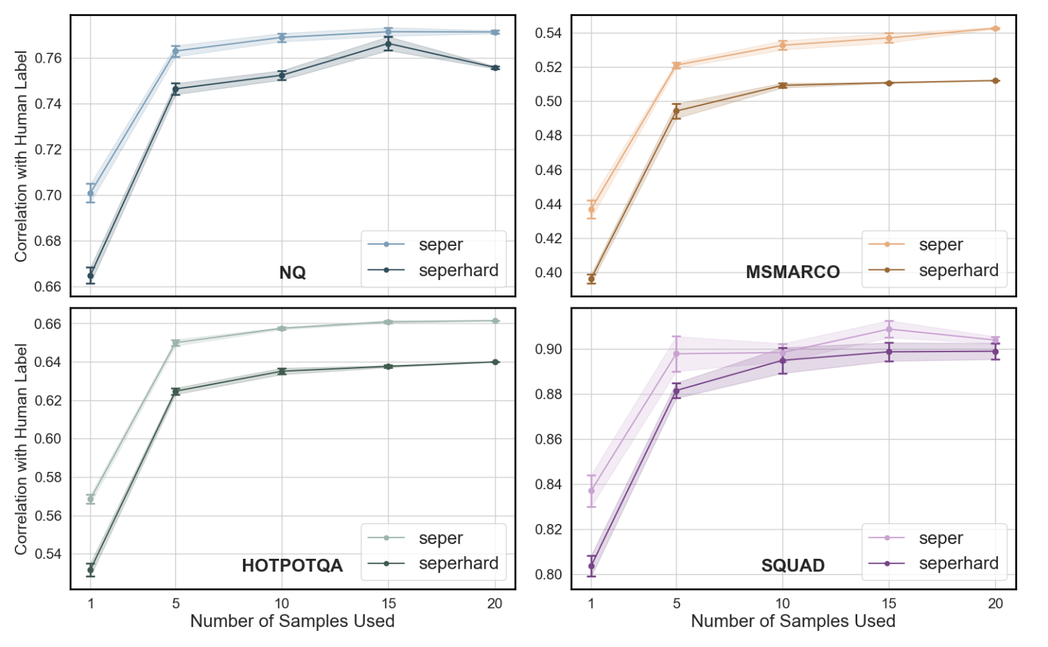
RESULTS
Well human-aligned
Fine-grained
Able to respond in multi-hop RAG
Align with human evaluation better than other measures with a large margin (~10%).
Unlock New Findings
Robust
Also,
and !
Fast
Through SePer, we can quantitatively measure:
Which size’s LLM benefit most from retrieval?
How does the number of retrieved items matter?
How do different prompt compression methods matter?
How does the reranking phase affect RAG?
Free
Robust across dataset and entailment model choice

Slide 8
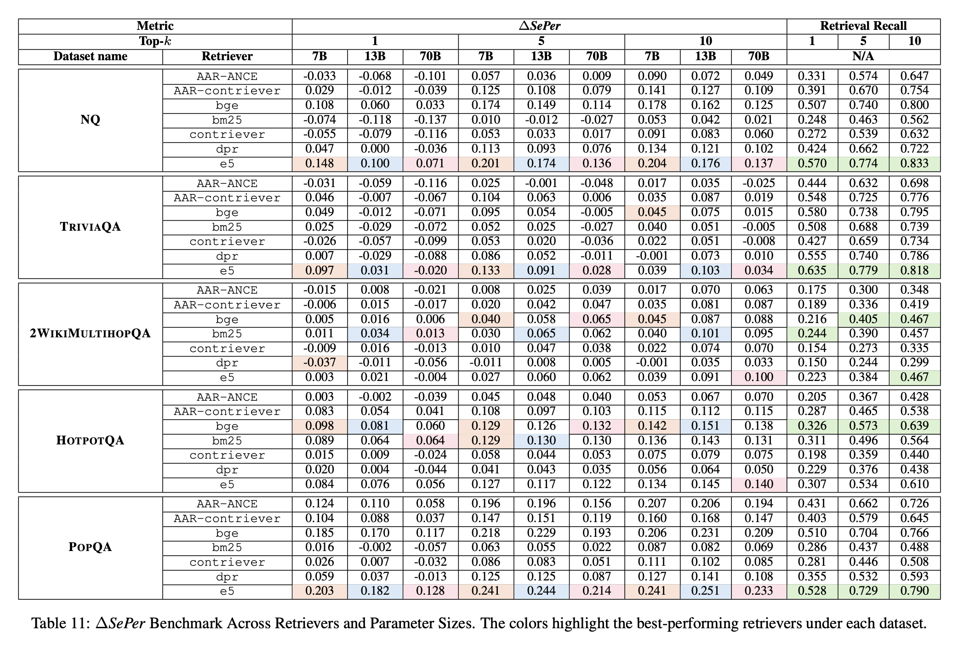
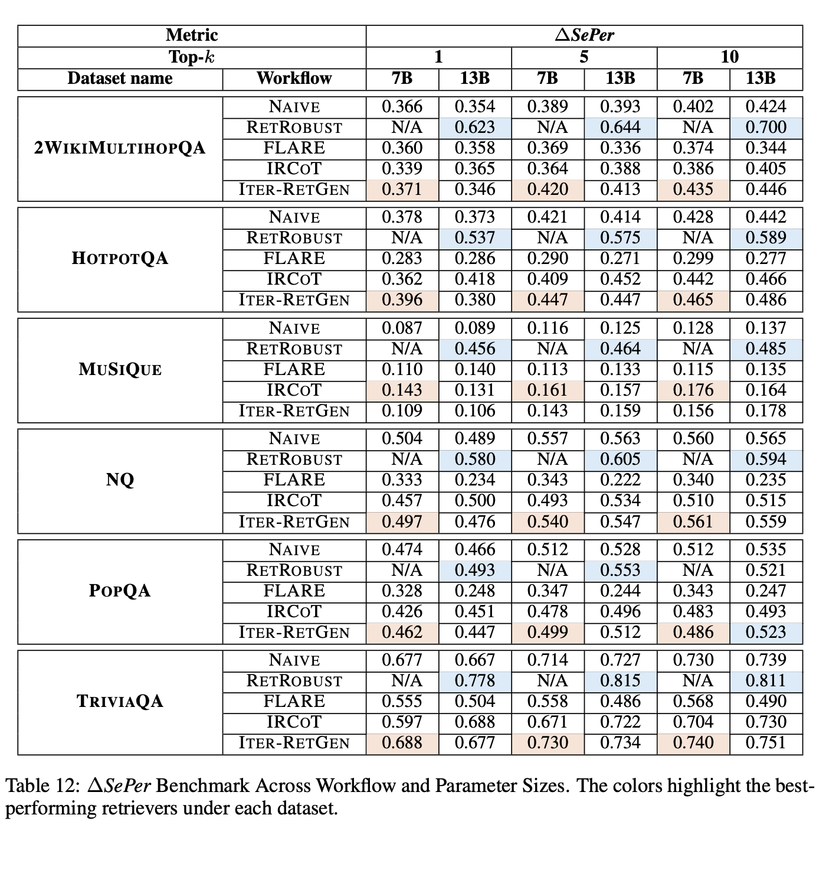
RESULTS
Benchmarking retrievers and RAG agentic workflows:

Slide 9

TAKE AWAY
SePer is a metric to evaluate the effectiveness/efficiency of modules in Agent/RAG in an automatic, convenient, and accurate way.
Project page:
https://sepermetric.github.io/
Code:
https://github.com/sepermetric/seper
Thank You!

